Slide 1
PROJECT PRESENTATION Flight Price PROJECT
Notes:
This template can be used as a starter file to give updates for project milestones.
Sections
Right-click on a slide to add sections. Sections can help to organize your slides or facilitate collaboration between multiple authors.
Notes
Use the Notes section for delivery notes or to provide additional details for the audience. View these notes in Presentation View during your presentation.
Keep in mind the font size (important for accessibility, visibility, videotaping, and online production)
Coordinated colors
Pay particular attention to the graphs, charts, and text boxes.
Consider that attendees will print in black and white or grayscale. Run a test print to make sure your colors work when printed in pure black and white and grayscale.
Graphics, tables, and graphs
Keep it simple: If possible, use consistent, non-distracting styles and colors.
Label all graphs and tables.

Slide 2
Project Overview
What is the project about?
Define the goal of this project
Data Collection
Notes:
What is the project about?
Define the goal of this project
Is it similar to projects in the past or is it a new effort?
Define the scope of this project
Is it an independent project or is it related to other projects?
* Note that this slide is not necessary for weekly status meetings

Slide 3
What is the project about?
Predicting flight prices is a common problem in the travel industry, as it can help airlines, online travel agencies, and other companies make more informed pricing decisions, and assist travellers in finding the best deals. There are a number of factors that can influence the price of a flight, including the route, the time of year, the day of the week, and the number of seats available. Additionally, external factors such as fuel prices, currency exchange rates, and economic conditions can also have an impact on flight prices. To predict flight prices, many companies use historical flight data and pricing information to build statistical models, which can then be used to make forecasts about future prices. Machine learning techniques such as linear regression, decision trees, and neural networks are commonly used to build these models. Additionally, a number of companies also make use of web scraping techniques to gather data from airline websites and other sources in order to build a dataset for their models

Slide 4
GOAL
Anyone who has booked a flight ticket knows how unexpectedly the prices vary. The cheapest available ticket on a given flight gets more and less expensive over time. This usually happens as an attempt to maximize revenue based on -
1. Time of purchase patterns (making sure last-minute purchases are expensive)
2. Keeping the flight as full as they want it (raising prices on a flight which is filling up in order to reduce sales and hold back inventory for those expensive last-minute expensive purchases)
So, I have to work on a project where you collect data of flight fares with other features and work to make a model to predict fares of flights.

Slide 5
DATA COLLECTION
Data was scrapped from Yatra website on domestic flights in India alone
Data contains 10683 entries each having 11

Slide 6
Showing the columns
Derivations of the columns in the dataset:_
Airline 10683 non-null object
Date_of_Journey 10683 non-null object
Source 10683 non-null object
Destination 10683 non-null object
Route 10682 non-null object
Dep_Time 10683 non-null object
Arrival_Time 10683 non-null object
Duration 10683 non-null object
Total_Stops 10682 non-null object
Additional_Info 10683 non-null object
10 Price 10683 non-null int64
Notes:
Same here we are not able to see the trend properly , need to analyze them individually

Slide 7
DATA CLEANING
The Steps followed in order to clean the data
From description we can see that Date_of_Journey is a object data type,
Therefore, we have to convert this datatype into timestamp so as to use this column properly for prediction
For this we require pandas to_datetime to convert object data type to datetime dtype.
Checking for duplicates- found none
Checking for null values- found only one , treated with drop function,
Splitting the categorical and numerical columns and assigning them to a variable for studying relationships.
Used transformation techniques –Transformer to reduce the skewness and also remove any outliers from the data.
One can find many ways to handle categorical data. Some of them categorical data are, Nominal data --> data are not in any order --> OneHotEncoder is used in this case.
Ordinal data --> data are in order --> LabelEncoder is used in this case.

Slide 8
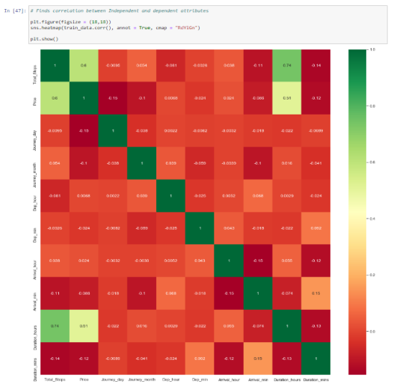
Correlation

Slide 9
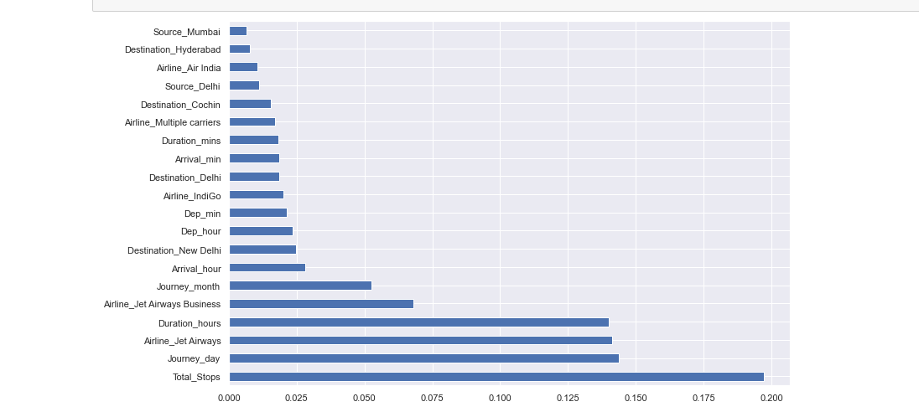
Top more correlated with Target

Slide 10
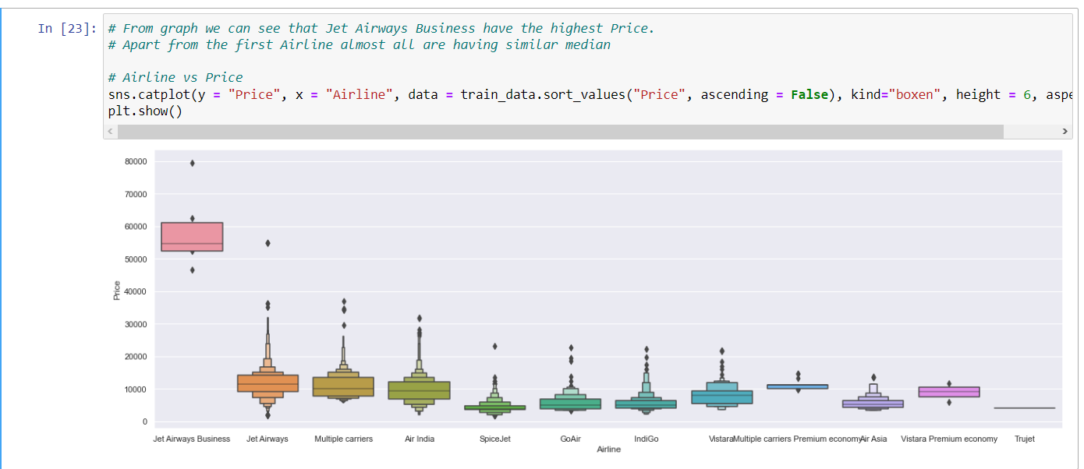
Visualization - EDA

Slide 11
We see Jet airways is the most prominent in the dataset

Slide 12
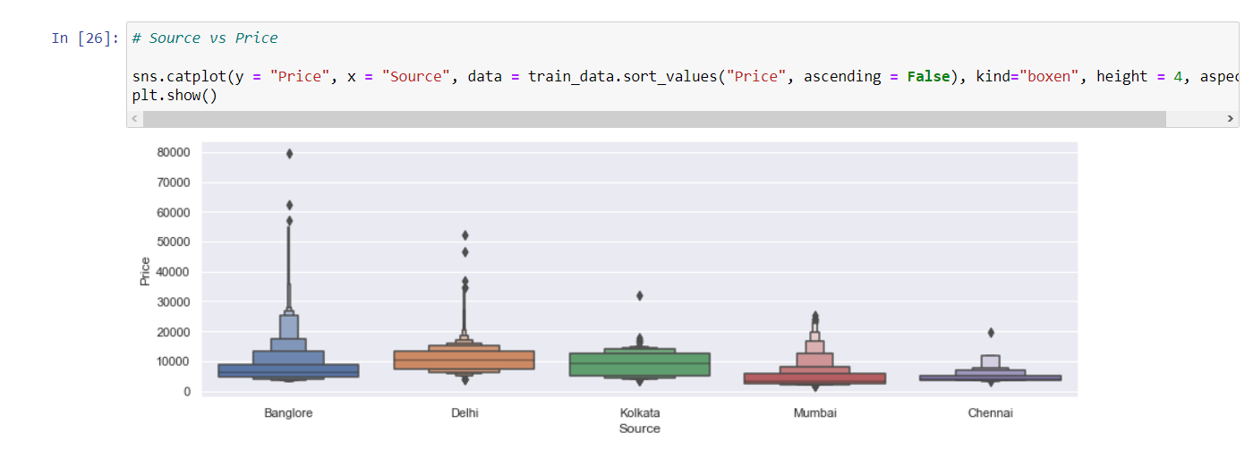
Price and Source

Slide 13
Bangalore is the highest by a small margin but equal to other metros

Slide 14
Imported Test data
Followed similar steps to remove nulls
Created a new columns called Flight Price with blank values
Split into X and y for features and target

Slide 15
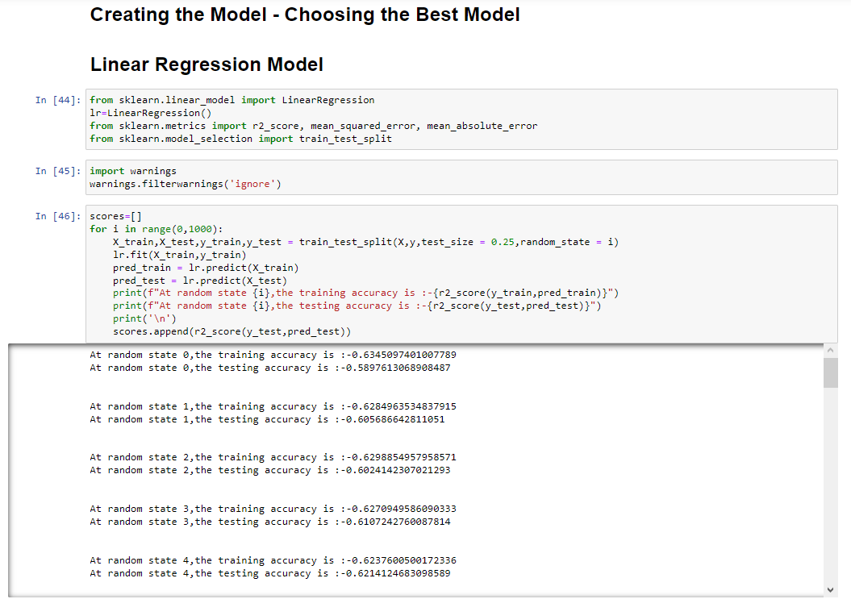
Model Evaluation
Regression

Slide 16
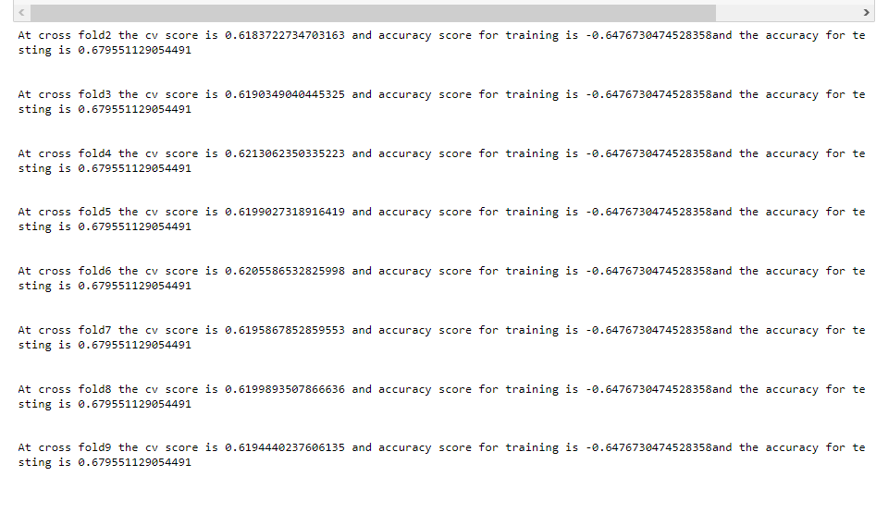
Cross Validation Score

Slide 17
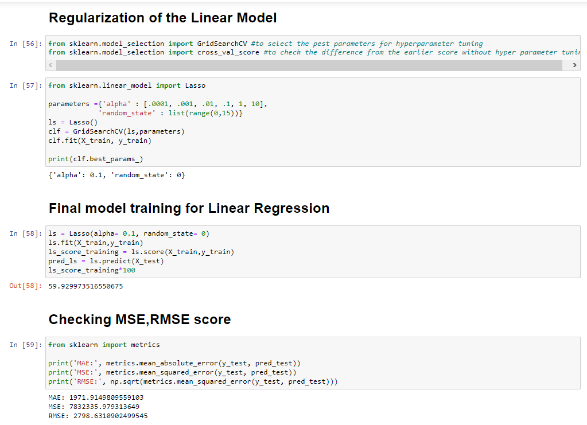

Slide 18
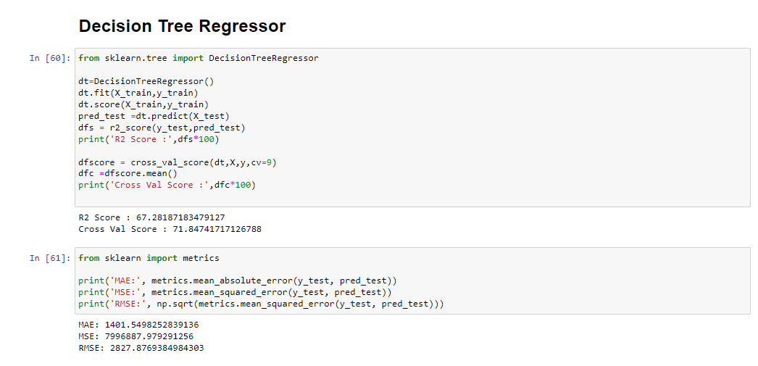

Slide 19
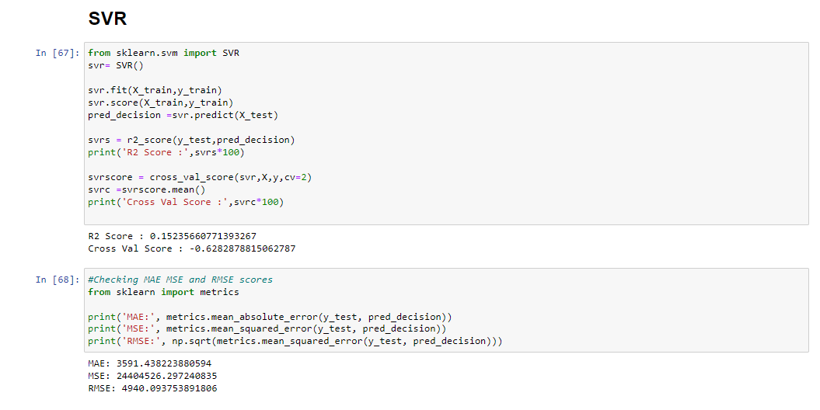

Slide 20
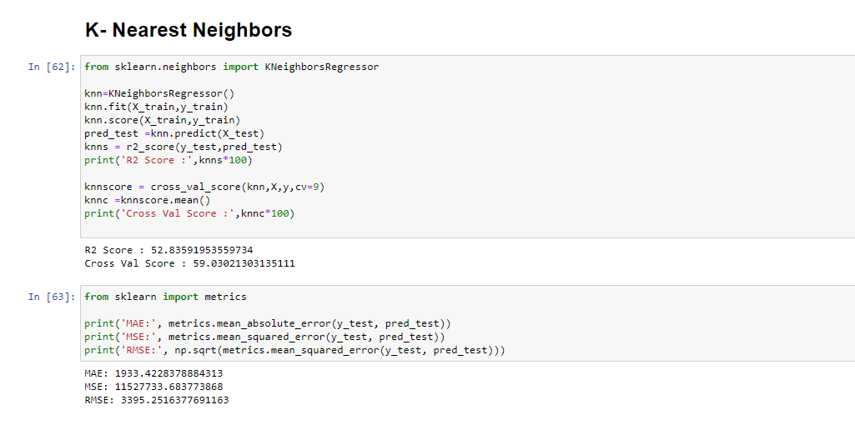

Slide 21
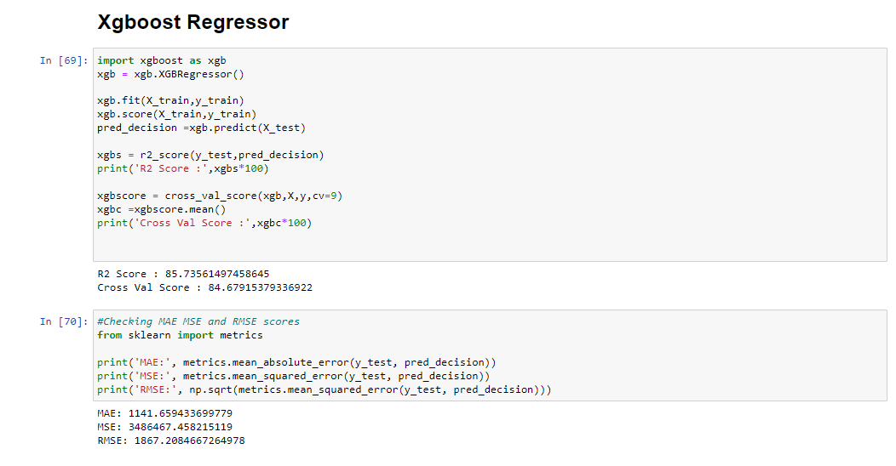

Slide 22
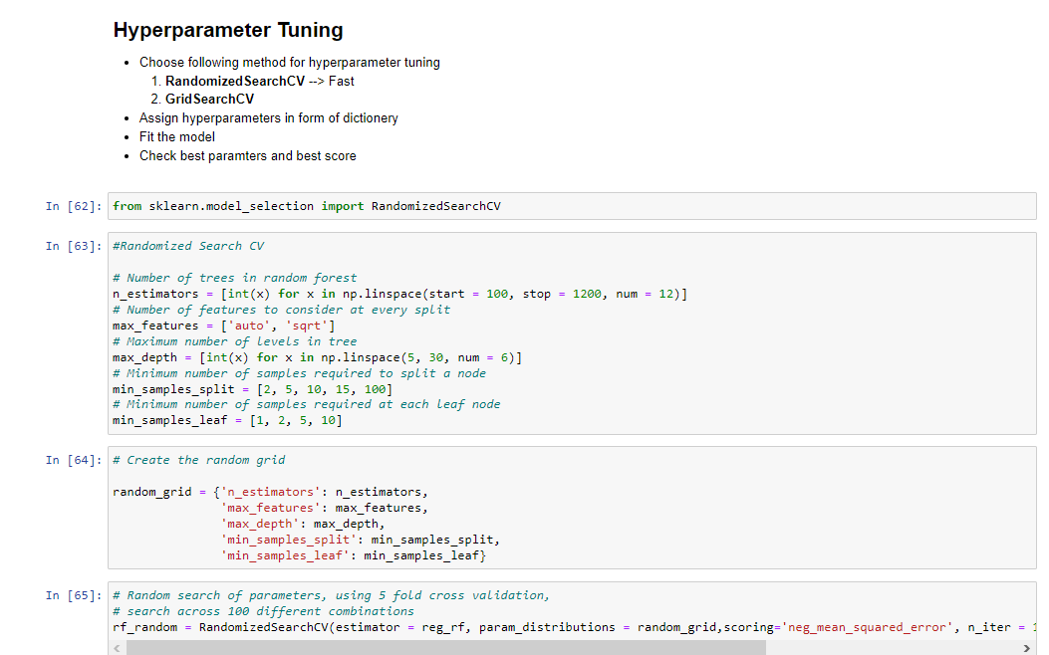
Hyper parameter tuning with Random forest Regressor

Slide 23
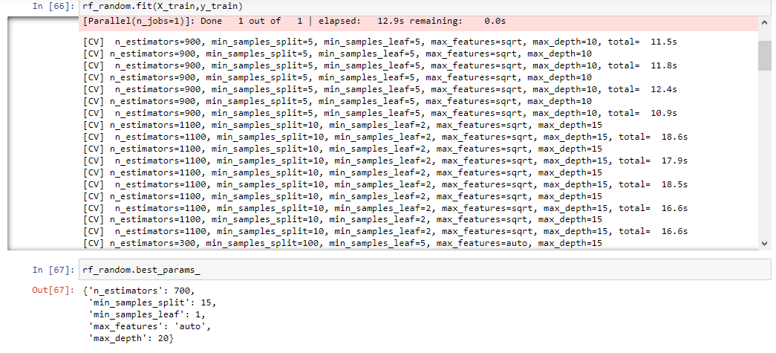
Metrics

Slide 24
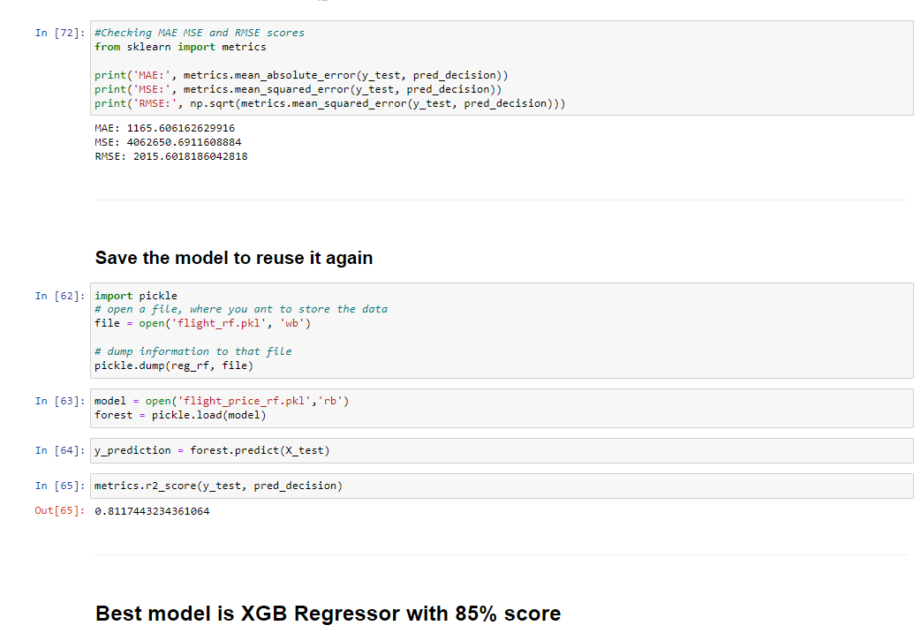
BEST MODEL is XGB

Slide 25
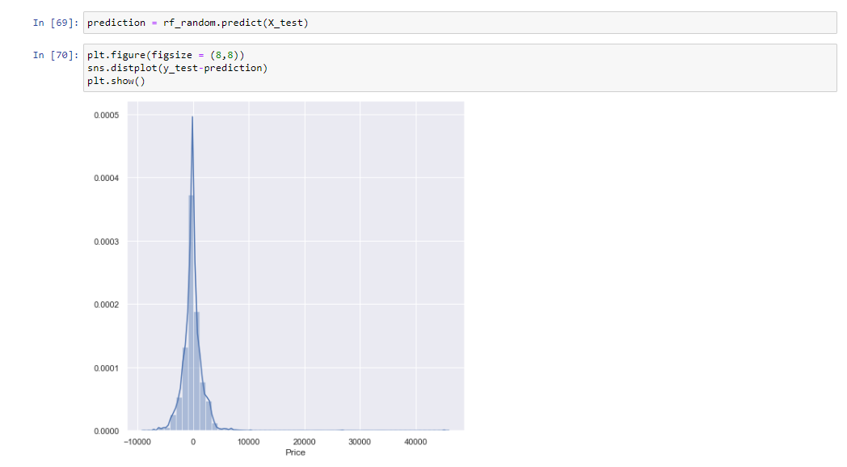
PLOTTING OF PREDICTIONS

Slide 26
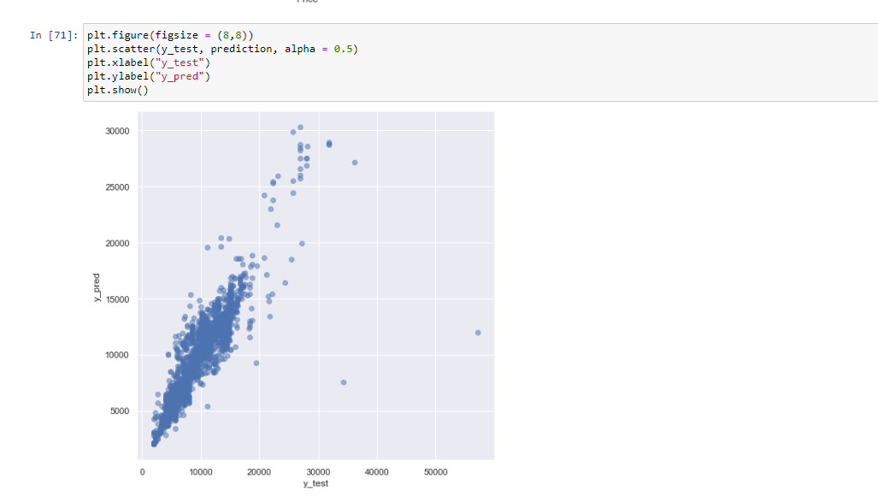

Slide 27
We have many features which have the most influence on the Target and having very impactful features it was really difficult to see prior to model building to come up with a good score or a good model , but since in Machine learning the computation is not statistical alone and the model actually learns the data as a whole , we are able to see such good scores. We see that in most situations we can go with Xgboost regressor as the model is not having overfitting or underfitting , it’s a strong model as well. If we are to use a substitute we can go for Random Forest regression as well as we saw it has a close score to Xgboost but the training was lesser, , But overall has a better and faster processing time so XGBoost regressor is the clear winner

Slide 28
Conclusion
XGoost Regressor gave the best score
Training score for XGB is 85%
Testing score for XGB is 100&
The train is higher than test which random forest didn’t have so we will use this model

